Slide 1

Simple rules for good research practice
良好研究实践的简单规则
Adrian Barnett, 29 November 2025
Queensland University of Technology 昆士兰科技大学
Photo by Bruno Mauricio on Unsplash
在 Unsplash Bruno Mauricio 的照片

Slide 2
Current state of research 科研现状
生物医学和公共卫生研究的设计、实施和分析中存在的可纠正缺陷可能会产生误导性结果，并浪费宝贵的资源。
小效应量难以与研究设计和分析引入的偏差区分。
缺乏详细的方案描述和研究记录质量差的情况很常见。
获得的信息可能无用或不重要，统计精度或功效通常过低或被误导使用。
对既往研究和继续进行的研究考虑不足。
任意选择分析方法和过分强调随机极端值可能会影响报告的结果。
Correctable weaknesses in the design, conduct, and analysis of biomedical and public health research studies can produce misleading results and waste valuable resources.
Small effects can be difficult to distinguish from bias introduced by study design and analyses.
An absence of detailed written protocols and poor documentation of research is common.
Information obtained might not be useful or important, and statistical precision or power is often too low or used in a misleading way.
Insufficient consideration might be given to both previous and continuing studies.
Arbitrary choice of analyses and an overemphasis on random extremes might affect the reported findings.
DOI: 10.1016/S0140-6736(13)62227-8

Slide 3
Current state of research 科研现状
研究人员队伍存在一些问题，包括未能聘请经验丰富的统计学家和方法学家，未能对临床研究人员和实验室科学家进行研究方法和设计方面的培训，以及利益相关者的参与存在利益冲突。
对研究决策的记录和研究的可重复性重视不足。
最后，奖励制度更注重数量而非质量，更注重创新而非可靠性。
Several problems relate to the research workforce, including failure to involve experienced statisticians and methodologists, failure to train clinical researchers and laboratory scientists in research methods and design, and the involvement of stakeholders with conflicts of interest.
Inadequate emphasis is placed on recording of research decisions and on reproducibility of research.
Finally, reward systems incentivise quantity more than quality, and novelty more than reliability.
DOI: 10.1016/S0140-6736(13)62227-8

Slide 4
Declaration of Helsinki 赫尔辛基宣言
“涉及人类参与者的医学研究必须具有科学合理且严谨的设计和执行，从而能够产生可靠、有效且有价值的知识，并避免研究浪费。研究必须符合公认的科学原则，以对科学文献和其他相关信息来源的透彻了解以及充分的实验室和（视情况而定）动物实验为基础。”
“在开展涉及人类参与者的医学研究中，科学诚信至关重要。参与研究的个人、团队和组织绝不能参与研究不端行为。”
“Medical research involving human participants must have a scientifically sound and rigorous design and execution that are likely to produce reliable, valid, and valuable knowledge and avoid research waste. The research must conform to generally accepted scientific principles, be based on a thorough knowledge of the scientific literature, other relevant sources of information, and adequate laboratory and, as appropriate, animal experimentation.”
“Scientific integrity is essential in the conduct of medical research involving human participants. Involved individuals, teams, and organizations must never engage in research misconduct.”
Updated in 2024

Slide 5

“There are only a handful of ways to do a study properly but a thousand ways to do it wrong”, David Sackett
做好研究的方法只有几种，但做错研究的方法却有千种。”
Photo by Barn Images on Unsplash

Slide 6

新冠病见证了数量激增的临床预测模型，DOI：10.1136/bmj.m1328
许多小型研究
过拟合风险高：对于这些数据来说，这是一个好模型，但对于新数据来说，这是一个坏模型。
在 600 个模型中，只有 6 个对政策制定有用
COVID-19 saw an explosion in clinical prediction models, DOI: 10.1136/bmj.m1328
Many small studies
High risk of over-fitting: A good model for these data, but a bad model for new data.
Out of 600 models, only 6 were useful for policy
Photo by Mufid Majnun on Unsplash

Slide 7
Growth of paper mills 论文工厂的生长
被标记（flagged）
表示论文已被标记或标明需要注意
通常是由于诸如抄袭、数据操纵、违反道德或同行评审违规等问题。
被标记的论文
doi: https://doi.org/10.1101/2025.08.29.673016

Slide 8
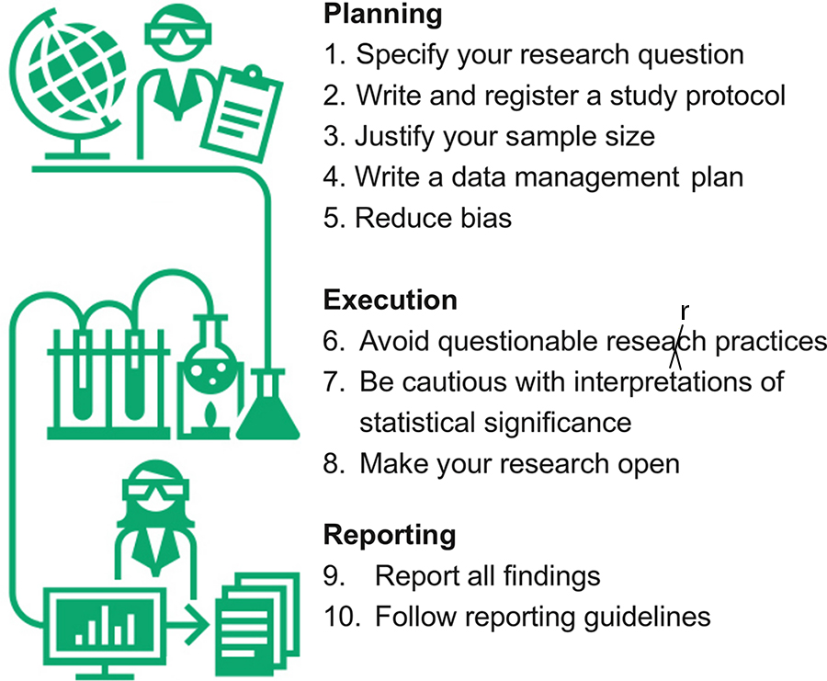
Ten simple rules for good research practice 十条良好研究实践的简单规则
规划
1. 明确研究问题
2. 编写并注册研究方案
3. 论证样本量的合理性
4. 撰写数据管理计划
5. 减少偏差
执行
6. 避免可疑的研究实践
7. 谨慎解读统计显著性
8. 公开开放您的研究
报告
9. 报告所有发现
10. 遵循报告指南
DOI: 10.1371/journal.pcbi.1010139

Slide 9
Rule 1. Specifying questions 规则 1. 明确具体的问题
两个好的研究问题示例：
更高的工作满意度是否意味着护士洗手更频繁？
与标准敷料相比，使用银涂层敷料是否能减少医院伤口感染？
不好的例子：
肥胖会缩短寿命吗？
Two good examples of research questions:
Does a higher job satisfaction mean that nurses wash their hands more?
Does using a silver-coated dressing reduce wound infections in hospital compared with a standard dressing?
Bad example:
Does obesity shorten life?

Slide 10

PICOT for specifying questions
Study population “P”
Intervention “I”
Comparison or control “C”
Outcome “O”
Time “T”
研究人群“P”
干预措施“I”
对照或控制“C”
结果“O”
时间“T”
Photo by Paul Hanaoka on Unsplash

Slide 11
Rule 1. Specifying questions 规则 1. 明确具体的问题
与标准敷料相比，使用银涂层敷料能减少院内伤口感染吗？
人群 = 院内感染患者
干预措施 = 银涂层敷料
对照 = 标准敷料
结果 = 感染（治愈或残留）
时间 = 从感染到住院结束？
Does using a silver-coated dressing reduce wound infections in-hospital compared with a standard dressing?
Population = patients with a hospital infection
Intervention = silver-coated dressing
Comparison = standard dressing
Outcome = infections (cured or remaining)
Time = from infection to end of hospital stay?

Slide 12

Rule 1. Specifying questions 规则 1. 明确具体的问题
应该包括大量阅读
近期的评论非常有帮助
你可以重复使用之前论文中的优秀想法，并注明致谢和引用。但不能抄袭方法。
Should involve a lot of reading
Recent reviews are really helpful
You can re-use the good ideas from previous papers with acknowledgement and citation. You can’t plagiarise methods.
Photo by Patrick Tomasso on Unsplash

Slide 13
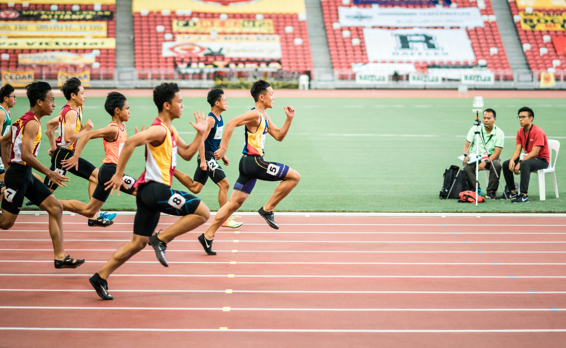
Rule 1. Specifying questions 规则 1. 明确具体的问题
常见错误：试图在一项研究中回答 5 个研究问题 = 1个糟糕的研究
补救措施：在 3 项研究中回答 1 到 2 个研究问题 = 3个更高质量的研究
放慢速度，反思过去的结果，为下一个问题提供参考
Common mistake: Trying to answer 5 research questions in one study = 1 bad study
Remedy: Answer 1 to 2 research questions in 3 studies = 3 better quality studies
Go slower, reflect on past results to inform the next question
Photo by Jonathan Chng on Unsplash

Slide 14
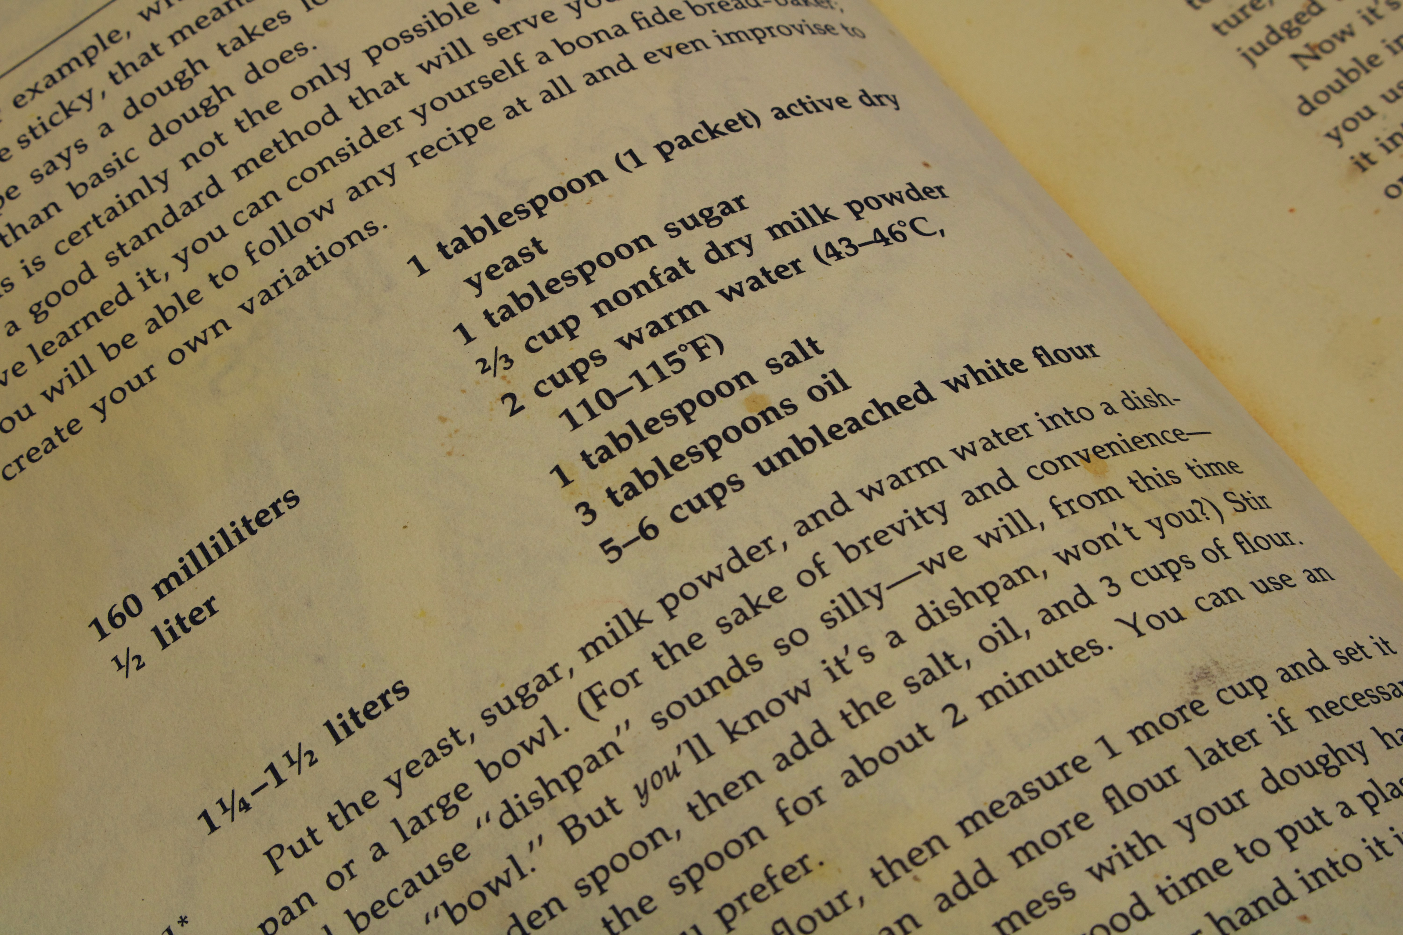
Rule 2. Write and register a study protocol 规则 2. 编写并注册研究方案
研究的问题和假设
人群描述
目标样本量
纳入/排除标准
研究设计，例如随机试验
数据收集
数据处理和转换
计划的统计分析
The research question and hypothesis
A description of the population
The target sample size
The inclusion/exclusion criteria
The study design, e.g., randomised trial
The data collection
The data processing and transformation
The planned statistical analyses
Photo by James Lee on Unsplash

Slide 15
Rule 2. Write and register a study protocol 规则 2.编写并注册研究方案
开始前多加思考总能带来更好的研究
考虑所有可能出错的地方
使论文写作更加轻松
可以免费在线发布方案，例如使用开放科学框架 (www.osf.io)
More thought before starting will always lead to a better study
Consider everything that could go wrong
Makes writing the paper much easier
Can publish a protocol online for no cost, e.g., with the Open Science Framework (www.osf.io)

Slide 16
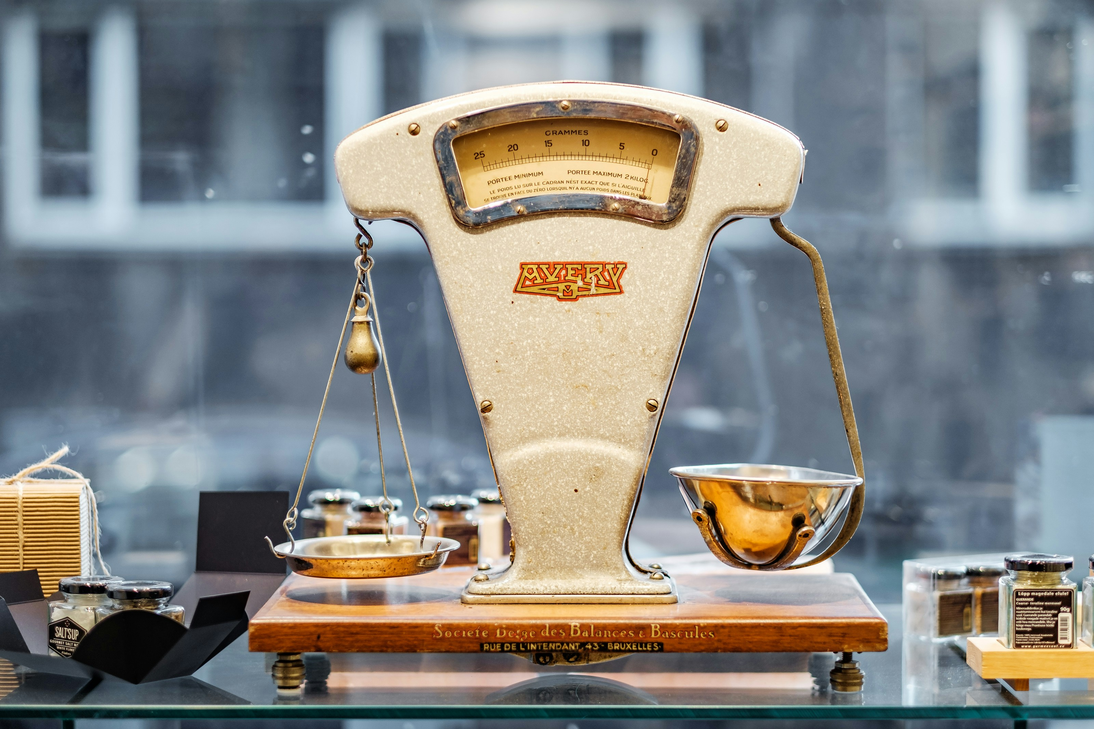
Rule 3. Justify your sample size 规则3. 论证样本量的合理性
我们需要多少人/参与者/患者来解答我们的研究问题？
人数足够多，以便有合理的机会解答研究问题。
在以下方面尽可能降低成本：金钱、决策延迟、参与者时间、您的时间（机会成本）
How many people/participants/patients we need to answer our research question
Sufficiently large to have reasonable chance of answering the research question
Have smallest possible costs in terms of: Money, Delayed decision, Participant time, Your time (opportunity costs)
Photo by Piret Ilver on Unsplash

Slide 17
Rule 3. Justify your sample size 规则3. 论证样本量的合理性
I型错误
-假阳性
你怀孕了
II型错误
-假阴性
你没有怀孕

Slide 18

Rule 4. Write a data management plan 规则4. 撰写数据管理计划
如果没有高质量的数据，整个研究都可能毫无意义。
最近的错误：将种族（分类）处理为连续数据，将月份（循环）处理为线性数据。
小心 Excel！https://doi.org/10.1080/00031305.2017.1375989
创建数据字典
虽然不令人兴奋，但很重要。
Without high quality data, the whole study can be pointless
Recent mistakes: ethnicity (categorical) treated as continuous, and month of the year (circular) treated as linear
Beware of Excel! https://doi.org/10.1080/00031305.2017.1375989
Create a data dictionary
Not exciting but is important
Photo by Sander Sammy on Unsplash

Slide 19
Rule 5: Reduce bias 规则5. 减少偏差
偏差在事实和您的数据之间造成系统性差异。
避免在调查问卷中提出诱导性问题，例如：问：您今天感觉如何？答：非常好、真的很好、不好。
减少缺失数据，例如，药物试验的参与者经常出现过敏反应而退出，这可能会造成治疗组和对照组之间的虚假差异。
混杂因素，即另一个变量才是真正的原因，例如，喝咖啡的人通常也吸烟，这可能会使咖啡看起来与肺癌有关。
Bias creates a systematic difference between the truth and your data
Avoid leading questions in surveys, e.g., Q: How well do you feel today? A: Excellent, really well, unwell.
Reduce missing data, e.g., participants in a drug trial often get an allergic reaction and drop-out, could create false differences between the treatment and control group
Confounding, where another variable is the real cause, e.g., coffee drinkers often also smoke, which can make coffee appear associated with lung cancer

Slide 20

Rule 6: Avoid questionable research practices 规则6.避免可疑的研究实践
P值操纵 = 重复分析数据，直至获得“显著”结果
选择性报告 = 忽略不利结果
歪曲事实 = 以过于正面的方式撰写结果
切香肠 = 将一个结果发表在多篇论文中，以提高指标
选择性引用 = 不引用相关研究，使其看起来更具原创性
HARKing = 假装研究问题是预先生成的，而不是在探索性分析中发现的
P-hacking = re-analysing data until a “significant” result is achieved
Selective reporting = leaving out unfavourable results
Spin = writing up results in a too favourable light
Salami slicing = publishing one result in multiple papers to boost your metrics
Selective citation = not citing relevant work to look more original
HARKing = pretending the research question was generated in advance rather than being found in exploratory analyses
Photo by Markus Spiske on Unsplash

Slide 21


Rule 7. Be cautious with interpretations of statistical significance 规则 7. 谨慎解读统计显著性
避免二分法思维
P值低于0.05 – 显著
P值高于0.05 – 不显著
许多论文存在：
假设检验过多
过分强调P值
Avoid dichotomous thinking
P-value below 0.05 – significant
P-value above 0.05 – non-significant
Many papers have:
Too many hypothesis tests
Too much emphasis on p-values

Slide 22
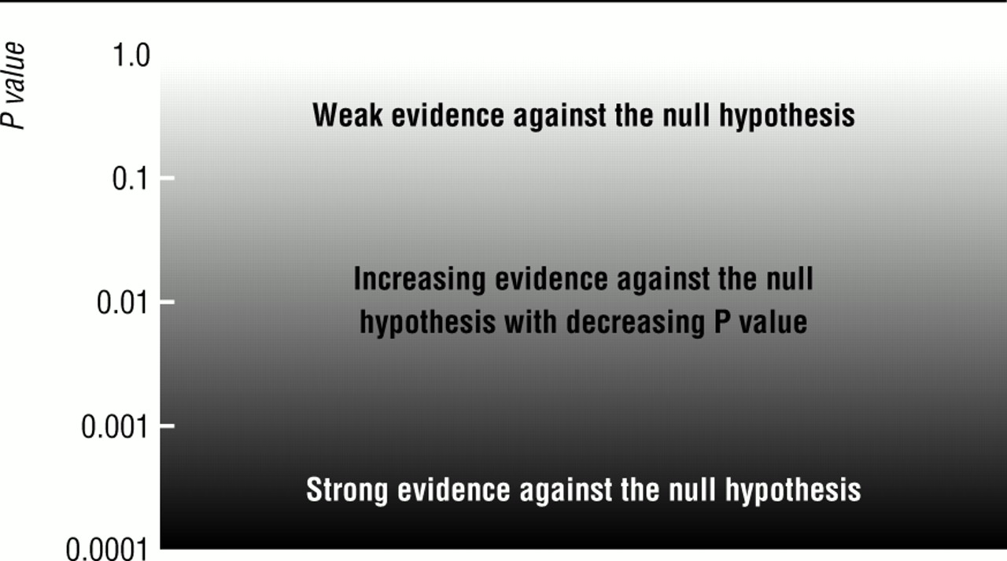
Rule 7. Be cautious with interpretations of statistical significance 规则 7. 谨慎解读统计显著性
反对零假设的证据薄弱
反对零假设的证据增加，P值降低
反对零假设的证据有力
Judge p-values on a sliding scale and in context
根据滑动比例和上下文判断p值
doi: https://doi.org/10.1136/bmj.322.7280.226 (

Slide 23

Rule 8. Make your research open 规则8. 公开开放您的研究
开放的研究更可信，也提升了研究的价值
更多审查是好事
允许他人以你的工作为基础
在 GitHub 上分享代码；对你来说真的很有用
Open research is more credible and increases the value of research
More scrutiny is a good thing
Allows others to build on your work
Share code on GitHub; really useful for you
Photo by Jan Tinneberg on Unsplash

Slide 24
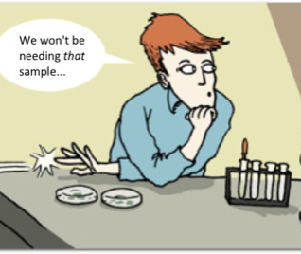
Rule 9. Report all findings 规则 9. 报告所有发现
失败或未达到预期结果的实验​​仍然很重要
被称为“文件抽屉”效应
Experiments that failed or that did not provide the expected result are still important
Called the “file drawer” effect

Slide 25
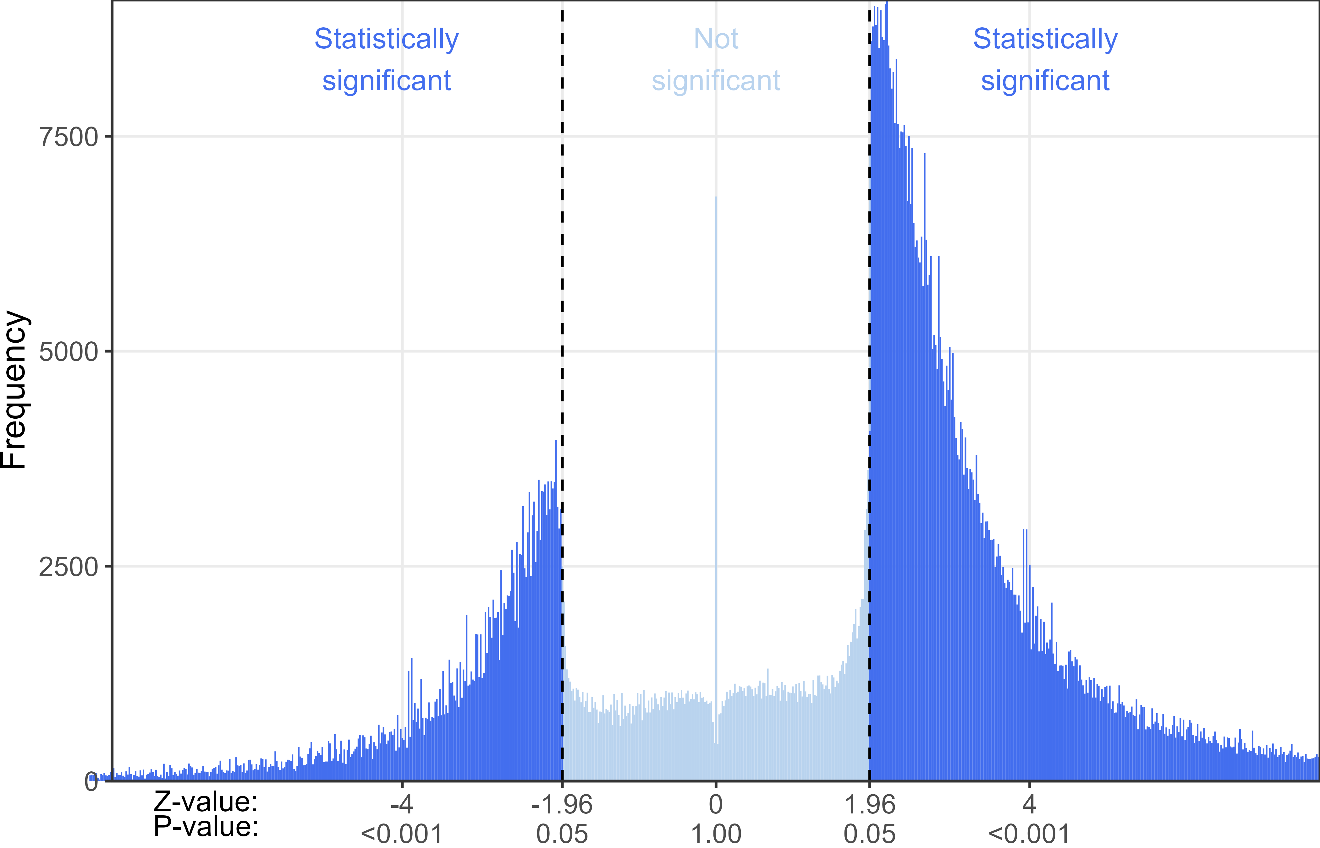
Rule 9. Report all findings 规则 9. 报告所有发现

Slide 26
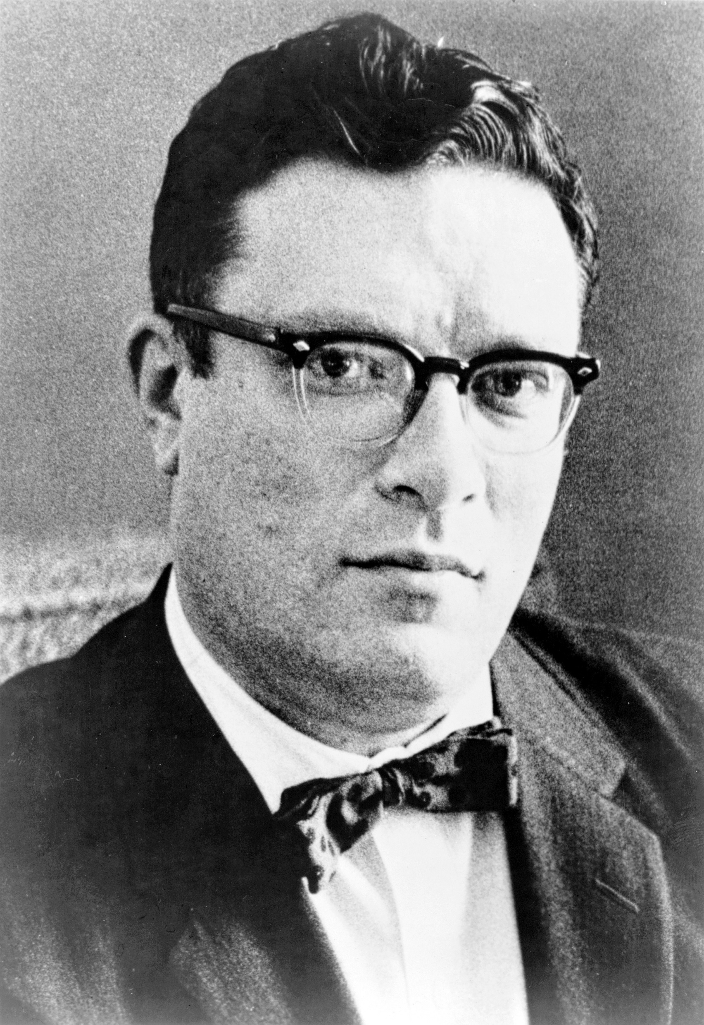
Rule 9. Report all findings 规则 9. 报告所有发现
在科学界听到的最激动人心的短语，预示着新发现的短语，不是“灵光一现的时刻”，而是“这是奇怪” - 艾萨克·阿西莫夫
The most exciting phrase to hear in science, the one that heralds new discoveries, is not “Eureka” but “That’s funny”, Isaac Asimov
Phillip Leonian from New York World-Telegram & Sun, Public domain, via Wikimedia Commons

Slide 27
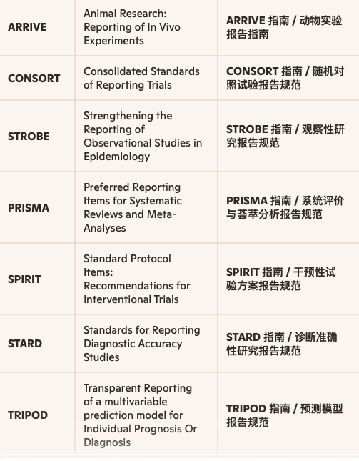
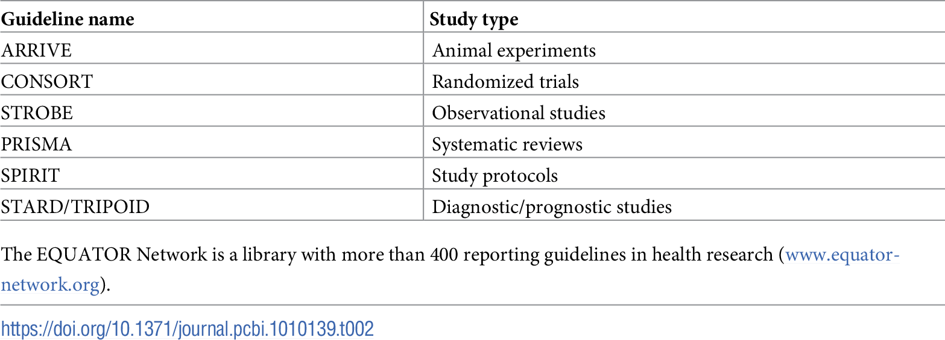
Rule 10. Follow reporting guidelines 规则10. 遵循报告指南

Slide 28

Overarching goals 总体目标
遵循这十条规则，你就能立即跻身质量排名前 10% 的科学家之列。
慢科学：质量重于数量。
多思考，多计划。
保持谦逊。https://doi.org/10.1038/s41562-021-01203-8
Following these 10 rules will immediately put you in the top 10% of scientists on quality
Slow science: Quality over quantity
Think more, plan more
Have humility https://doi.org/10.1038/s41562-021-01203-8
Photo by david clarke on Unsplash

